Slide 1
Task 3

Slide 2
Report:
Title: Cross Site Scripting
Domain: http://testasp.vulnweb.com/
Subdomain: http://testasp.vulnweb.com/Search.asp
Steps to Reproduce:
Step 1: Visit http://testasp.vulnweb.com/
Step 2: On the top menu you will find a search option.
Step 3: Click on it and you will be prompted with the Search box.
Step 4: In the Search Box type: <script>alert(1)</script>
Step 5: Click Search and the XSS will get triggered.
Step 6: You can also use different XSS payloads or Simply intercept the request on Burp Suit.
Step 7: Sent the request to intruder and paste all the Payloads.
Step 8: You will find Many Successful payloads of XSS.
Tested on Firefox
IMPACT: The Attacker can steal data from whoever checks the report.
Cookie Stealing - A malicious user can steal cookies and use them to gain access to the application.
Defacement - attacker can deface the website using JavaScript code.
Malware Download – It can prompt user to Download Malware
MITIGATION: Disable Cross Site Scripting by enabling noscript on website.

Slide 3
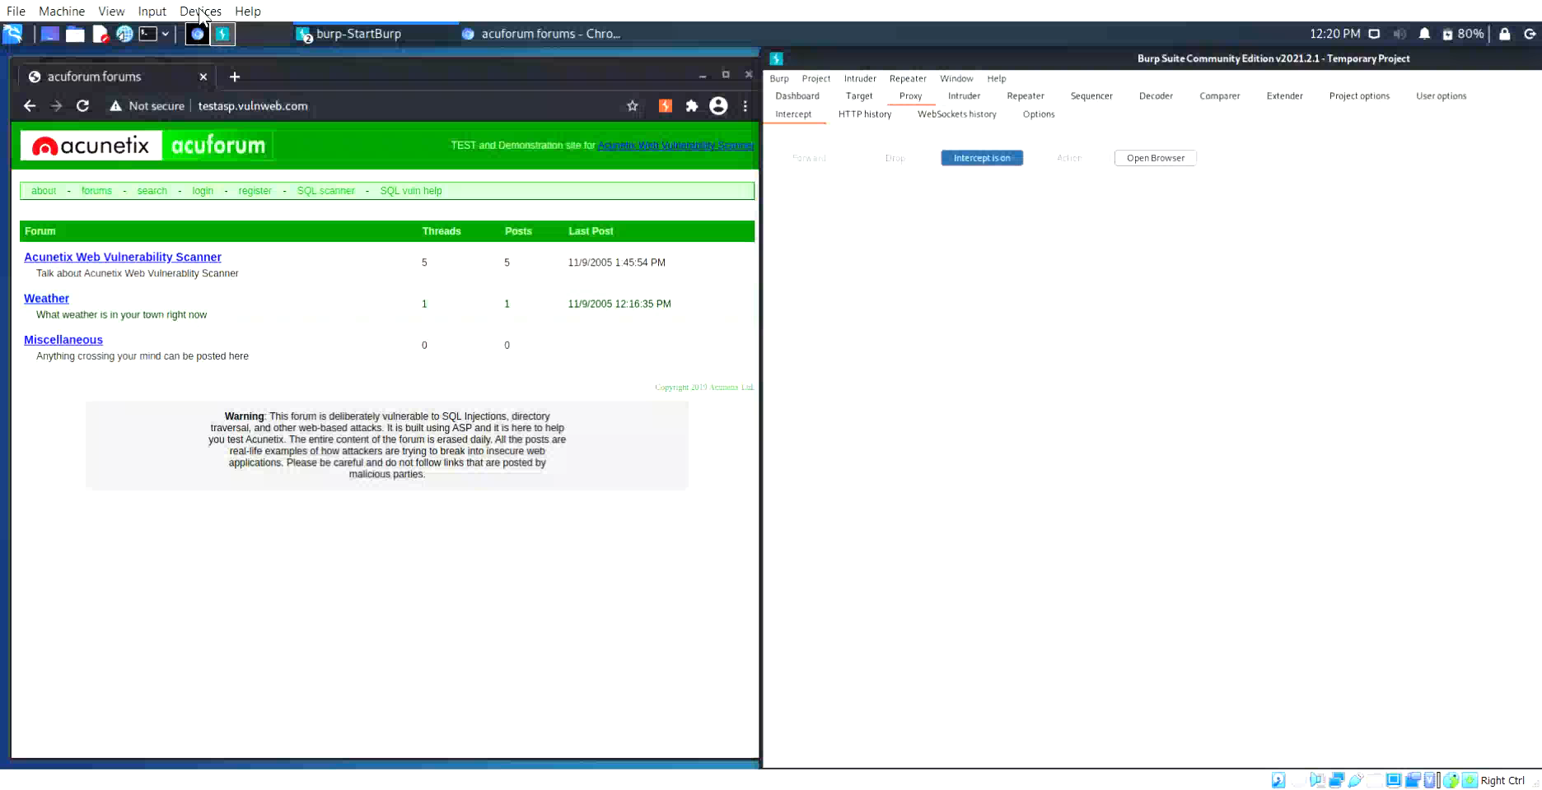
Video:

Slide 4
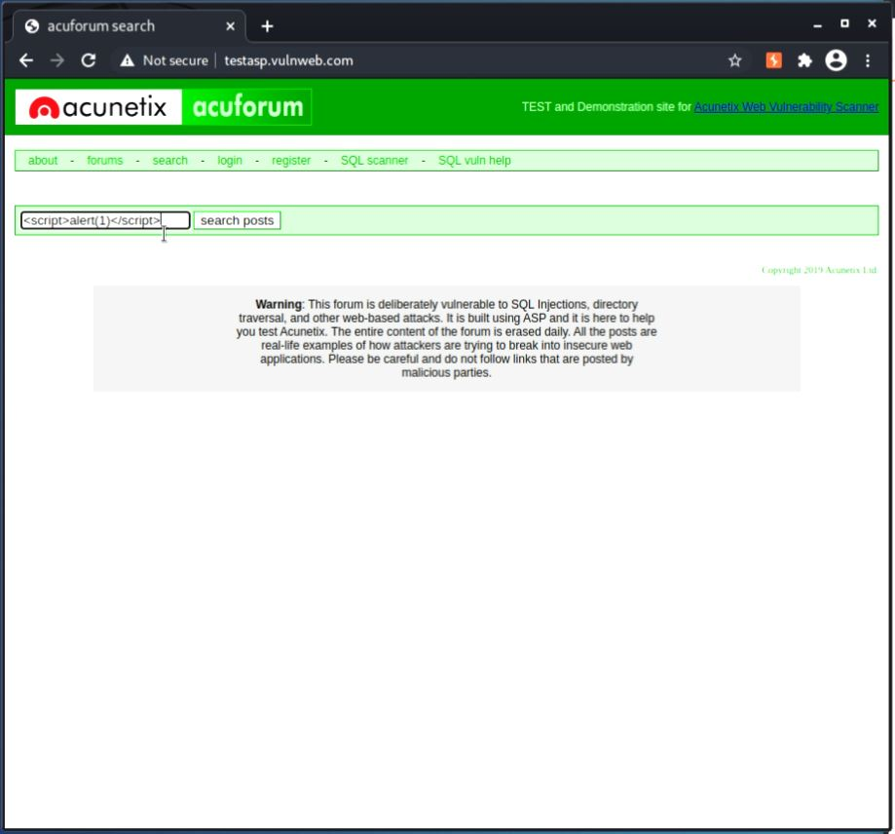
Screenshots:

Slide 5
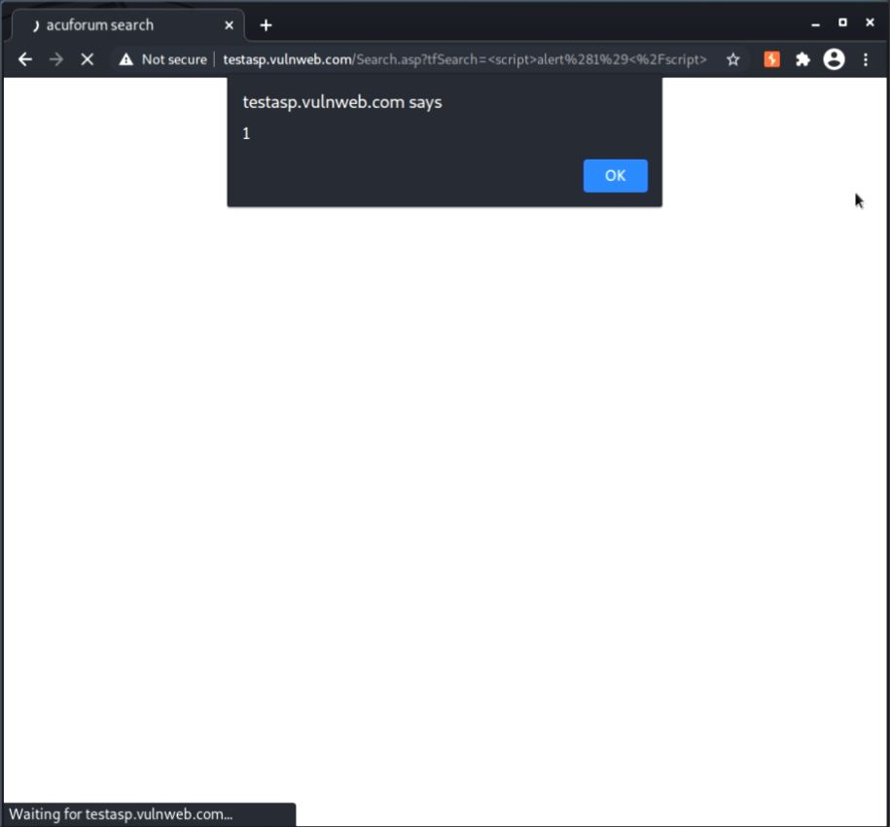

Slide 6
